Slide 1
HeadLess Drupal
The traditional approach to Drupal architecture, also referred to as coupled Drupal, is a monolithic implementation where Drupal maintains control over all front-end and back-end concerns. This is Drupal as we've known it — ideal for traditional websites. If you're a content creator, keeping Drupal in its coupled form is the optimal approach, especially if you want to achieve a fast time to market without as much reliance on front-end developers. But traditional Drupal 8 also remains a great approach for developers who love Drupal 8 and want it to own the entire stack.

Slide 2
HeadLess Drupal
A second approach, progressively decoupled Drupal, offers an approach that strikes a balance between editorial needs like layout management and developer desires to use more JavaScript, by interpolating a JavaScript framework into the Drupal front end

Slide 3
HeadLess Drupal
This involves a complete separation of concerns between the structure of your content and its presentation. In short, it's like treating your web experience as just another application that needs to be served content. Even though it results in a loss of some out-of-the-box CMS functionality such as in-place editing or content preview, it's been popular because of the freedom and control it offers front-end developers.

Slide 4
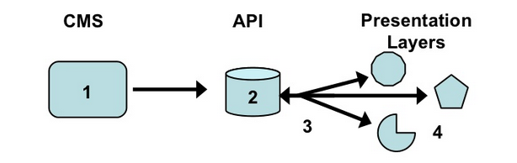
How Decoupled Drupal Works

Slide 5
HeadLess Drupal
A headless content management system (CMS) delivers back-end capabilities for editing, organizing and storing all types of digital information, without regard to how that content is published
In short, with Headless Drupal, a visitor to the website will not interact with Drupal directly. Often, in Headless Drupal, the visitor will see pages created with Javascript frameworks such as Angular.js or Backbone.js. In this situation, Drupal is mainly used as store for data that is then read by the framework.

Slide 6
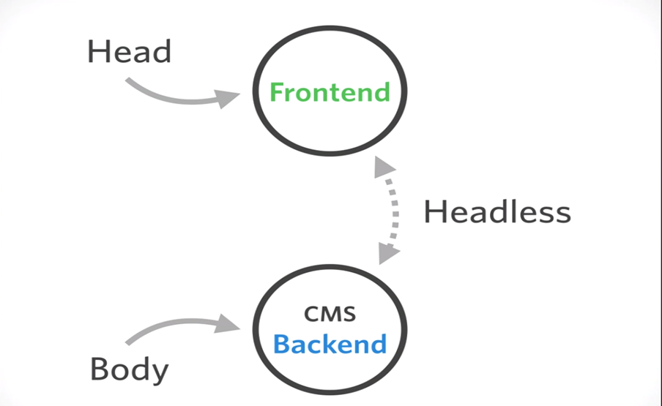
HeadLess Drupal

Slide 7
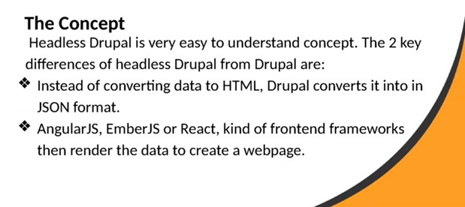
Headless Drupal

Slide 8
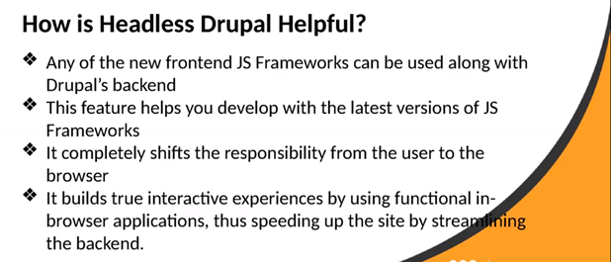
Headless Drupal

Slide 9
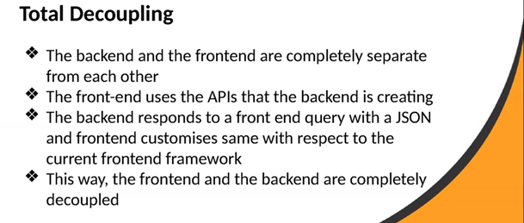
Headless Drupal

Slide 10
Where did headless Drupal come from?
As the web has evolved, the desire to control and display content across different devices and platforms has increased. Early on this meant connecting website data to display on native phone applications, or communicating with enterprise business hardware and software.
With the advent of Javascript frontend frameworks like Angular, Ember and React, the void for "headless" (or "decoupled") content management systems has grown. During Drupal 7’s tenure, the community made contributions to fill the void left by new frontend frameworks. This decentralizing of content display motivated the industry to create storage for holding and managing content. When Drupal 8 was released, this ability was built into core. Drupal offered a progressive solution to the problem of decentralized content.

Slide 11
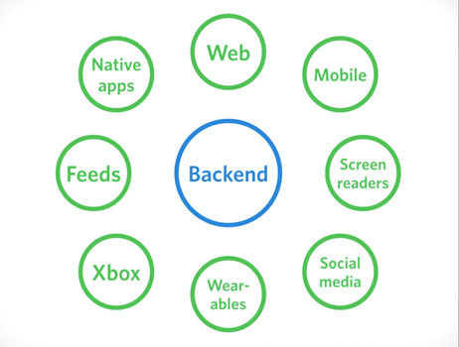
Where did headless Drupal come from?

Slide 12
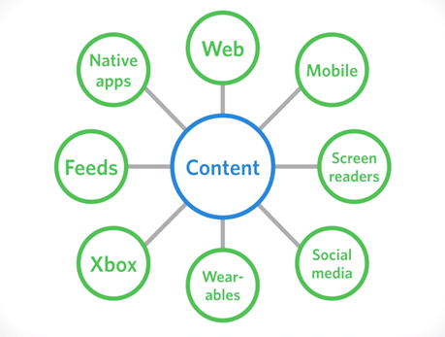
Where did headless Drupal come from?

Slide 13
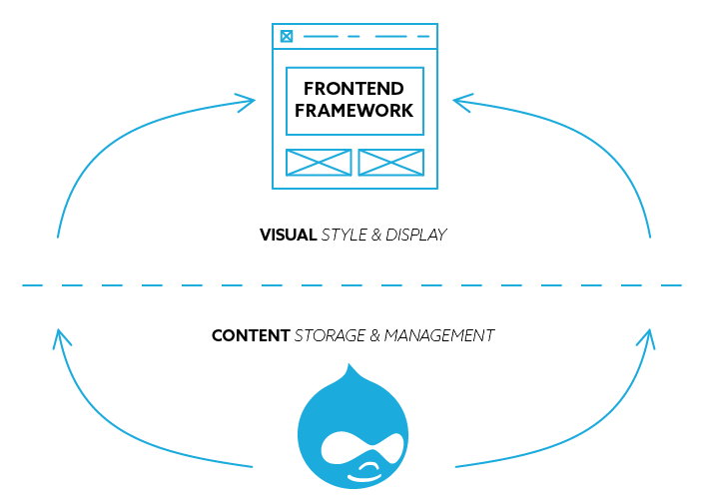
HeadLess/Decoupled Drupal

Slide 14
How Decoupled Drupal Works
Decoupled Drupal (or headless Drupal) allows the developer to utilize any technology to render the front-end experience in lieu of the theming and presentation layers in Drupal. This process utilizes Drupal as a content service. The Drupal back end exposes content to other systems, such as native applications, JavaScript applications, and IoT devices.
Drupal also supports a robust offering of web services, including the core REST API, JSON API, and GraphQL, in addition to SDKs like Waterwheel.js (JavaScript) and Waterwheel. swift (Swift). This means that any system can consume content from Drupal with ease.

Slide 15
How Decoupled Drupal Works
Usually, when someone opens the Drupal site in a browser he (or she) sees the themed output (head) that Drupal generates by itself. Thus with the decoupled approach, we handle Drupal’s job of creating and displaying HTML to the front-end framework like Angular or Backbone.js. Drupal still deals with the back-end part and it is used as a content management system but now it’s “headless”.
So we can link front-end framework or mobile app to Drupal and use it for displaying data. For that, we have to create a Drupal RESTful API which helps us to exchange data between the different parts of the application and connect them all together.

Slide 16
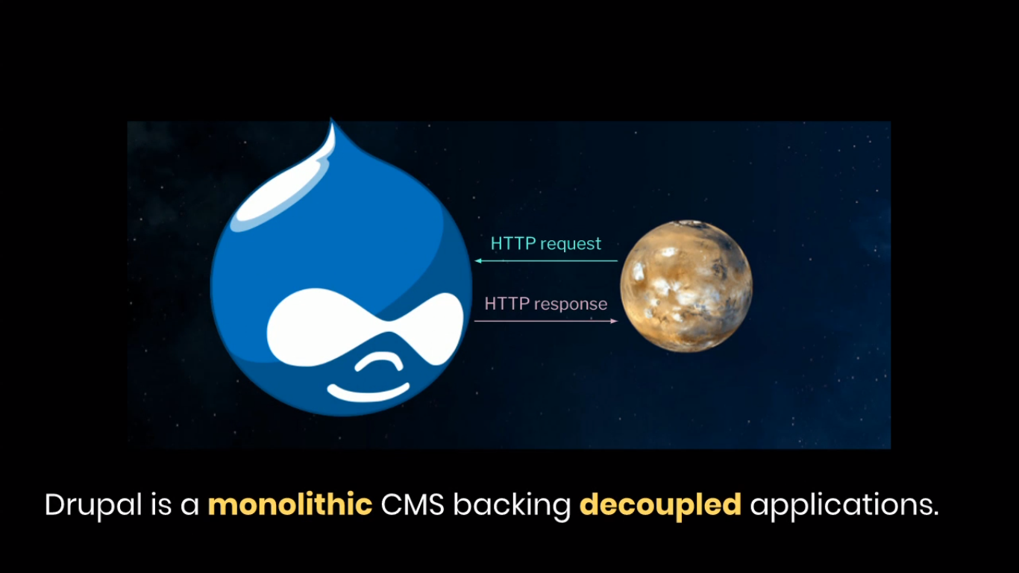
How Decoupled Drupal Works

Slide 17
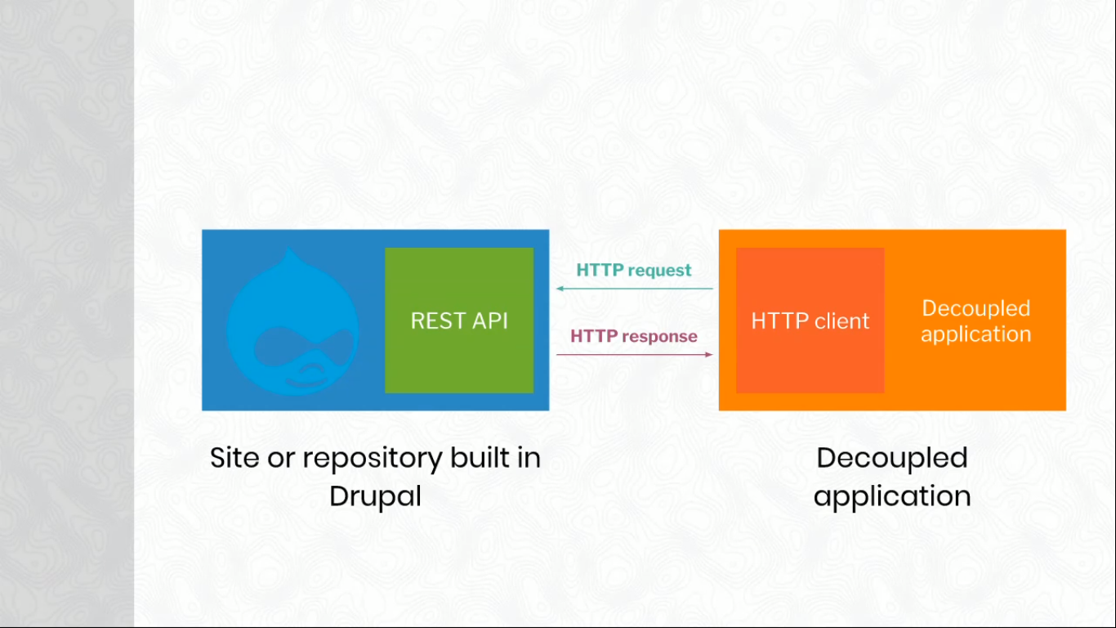
How Decoupled Drupal Works

Slide 18
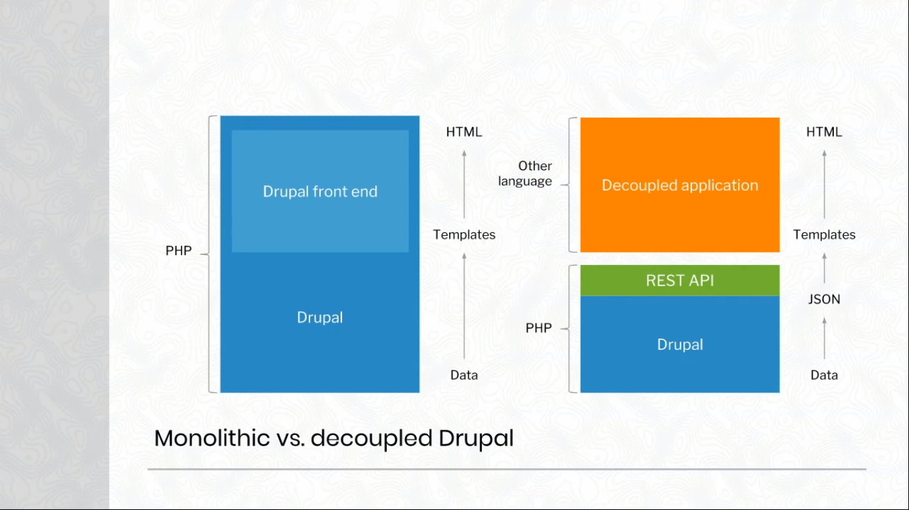
How Decoupled Drupal Works

Slide 19
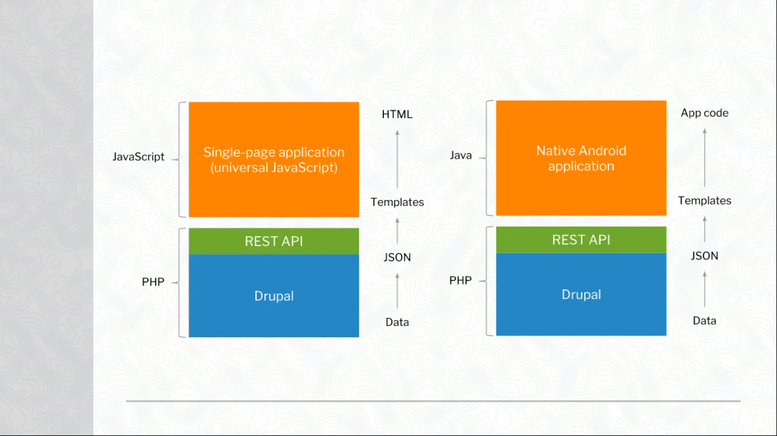
How Decoupled Drupal Works

Slide 20
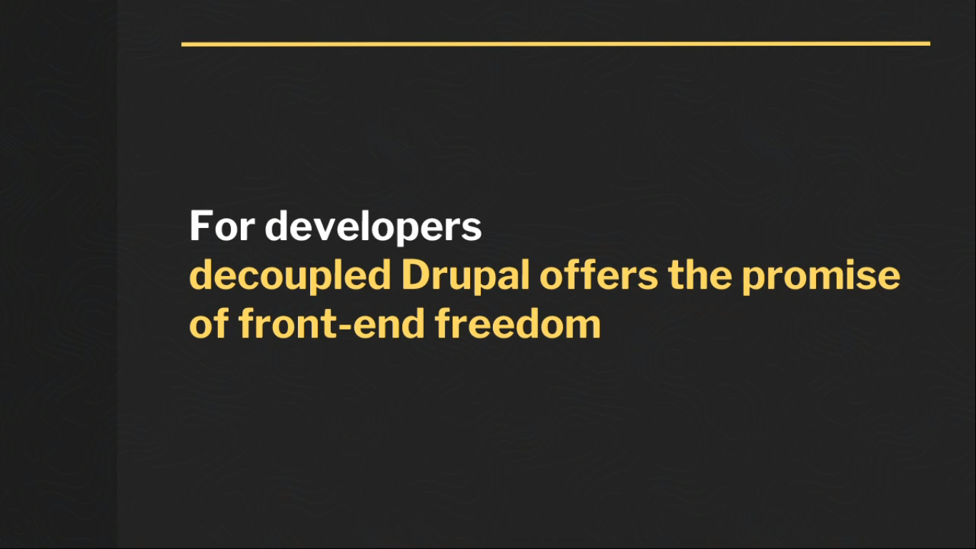
How Decoupled Drupal Works

Slide 21
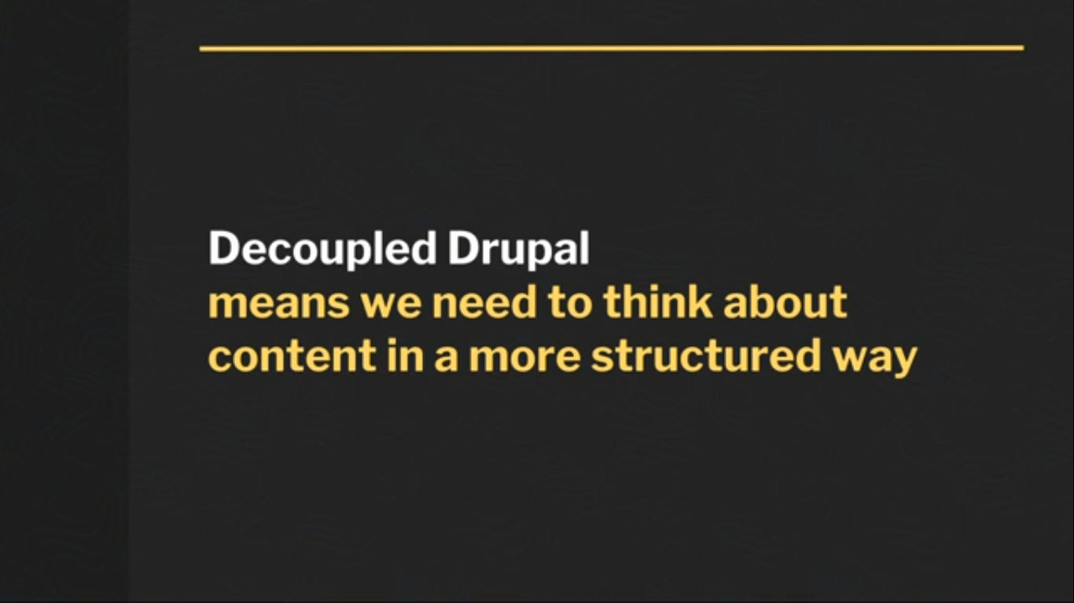
How Decoupled Drupal Works

Slide 22
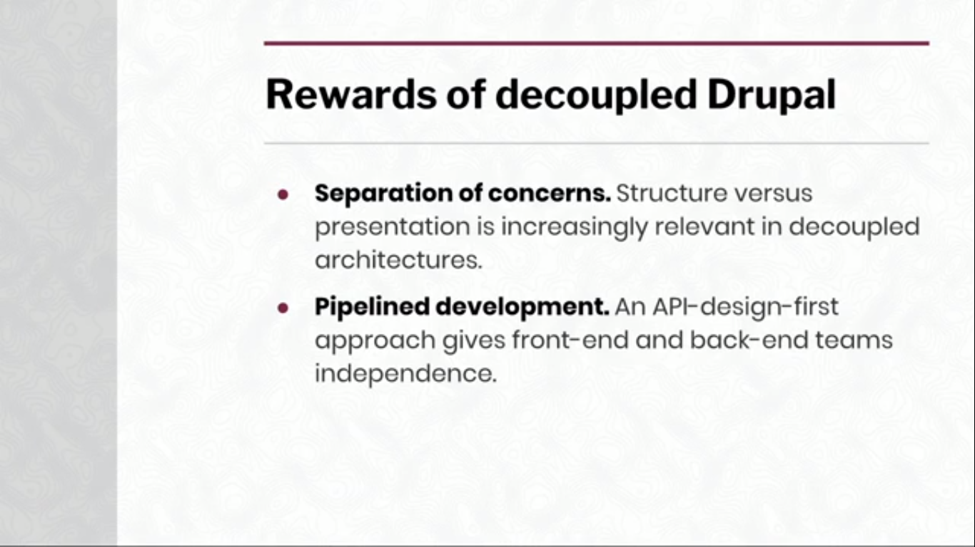
How Decoupled Drupal Works

Slide 23
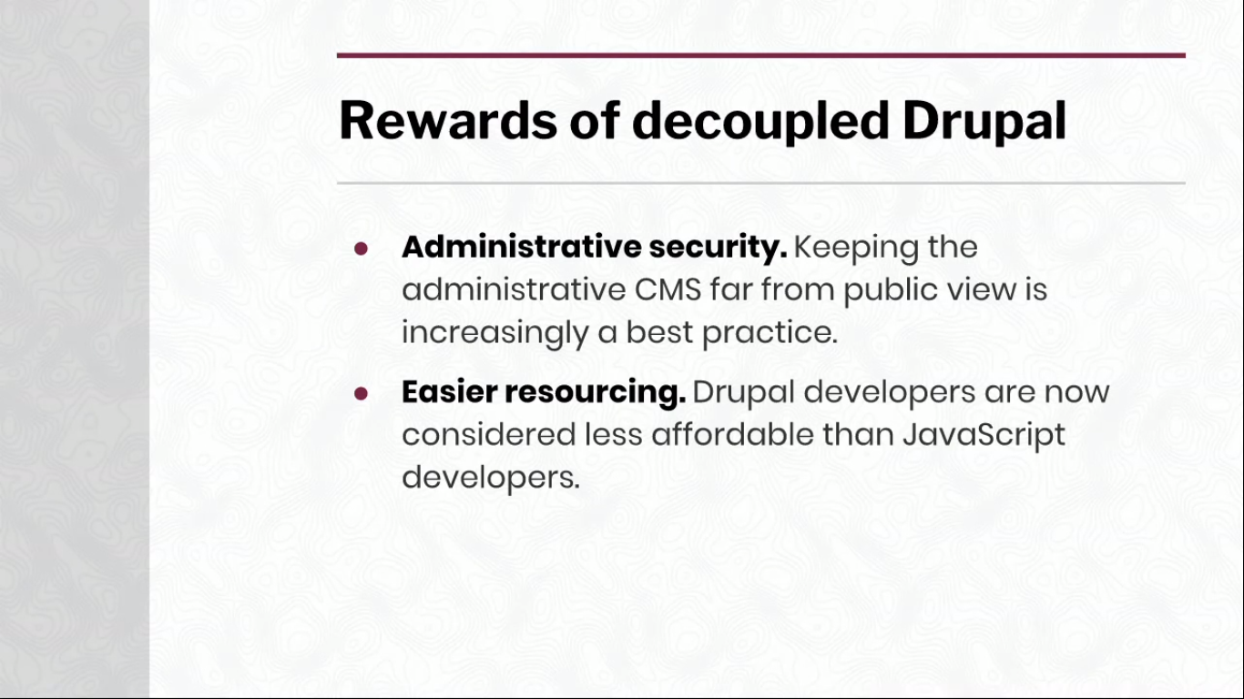
How Decoupled Drupal Works

Slide 24
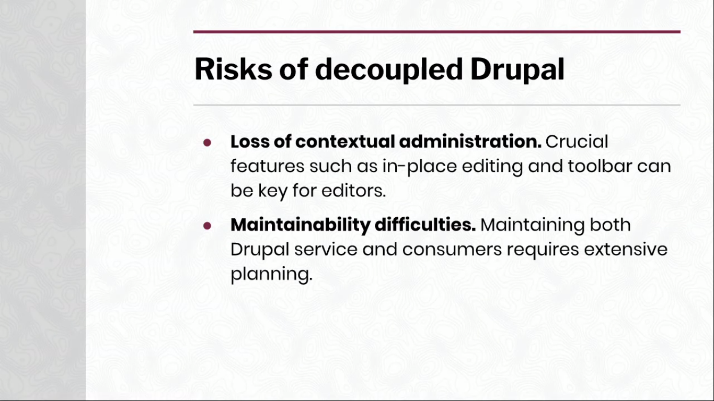
How Decoupled Drupal Works

Slide 25

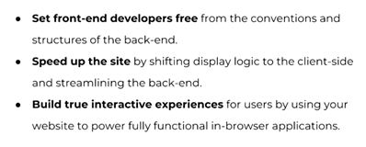



Headless Makes Sense When Want to :

Slide 26
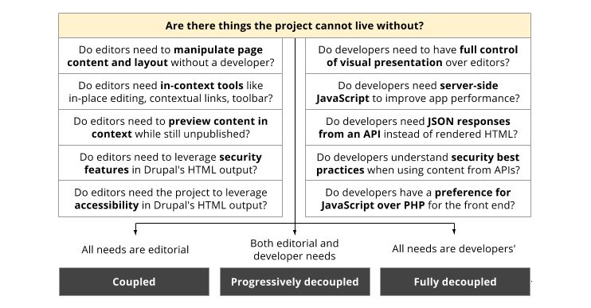
Coupled Vs Decoupled Drupal

Slide 27
WHAT ARE THE BENEFITS OF DECOUPLING?
Simplified upgrade paths. A CMS upgrade doesn’t have to affect the presentation layer, only the CMS.
Easier troubleshooting. Bugs are easier to locate when your platform is composed of smaller, discrete parts instead of one giant application.
Easier to harden against regressions. Back-end developers can introduce changes that break front-end functionality more easily in a monolithic application. In a headless strategy, the API can be tested easily, helping you catch potentially breaking changes earlier in the process.
Focused tooling; granular deployments. Developers need only concern themselves with the setup and tooling specific to their part of the stack. Back-end devs don’t need to compile CSS; front-end devs don’t have to worry about composer installs. Likewise, deployments in decoupled projects can be much smaller and more nimble.

Slide 28
WHAT ARE THE BENEFITS OF DECOUPLING?
Clearer separation of scope and concerns. Since the CMS is just an API, it is easy to establish clear roles based on your content strategy. In contrast, a monolithic CMS can make it difficult to draw a line between syndication of content and serving a website.
Improved performance. While a monolithic Drupal site can perform very well, the need to frequently bootstrap Drupal for user requests can slow things down. Depending on your project’s needs and your caching strategy, these requests might be inevitable. A headless architecture allows you to build a front-end application that handles these requests more efficiently, resulting in better performance.
Divide and conquer development. Teams are able to develop in a decoupled manner. Development of a new feature can happen simultaneously for both the front-end and back-end.

Slide 29
Drupal 8 Lightning
Lightning is a Drupal distribution that curates the best Drupal modules and patches to provide a great experience for editorial teams and developers out of the box. For our purposes, it’s most useful because it provides a preconfigured Content API feature, which automatically exposes a JSON-based REST API for content types, fields, media, and other entities.
Headless Lightning
Headless Lightning is a sub-profile of Lightning that includes all of the same features, but additionally provides a simplified administrative interface designed especially for decoupled sites, as well as editorial teams who might not be as comfortable with Drupal’s administrative patterns.
Lightning and Headless Lightning are each great choices for decoupled applications, since they share the common Content API feature. For the purposes of this tutorial, however, we will assume you are using Headless Lightning.

Slide 30
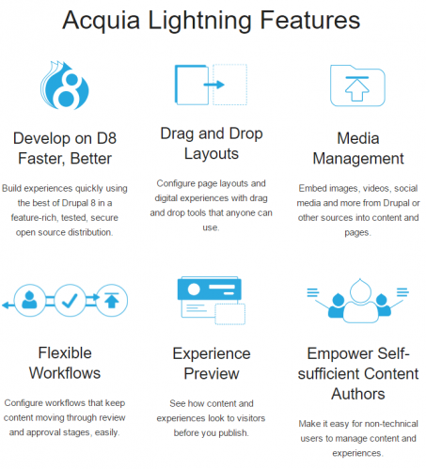

Slide 31
How to Create Portal Using Headless Drupal
PREREQUISITES
HTML5, CSS3, BOOTSTRAP
JAVA SCRIPT, JQUERY, JSON
NODEJS, ANGULARJS, TYPESCRIPT, ANGULAR 6
DRUPAL LIGHTNING, REST-API

Slide 32
How to send the JSON data from a Drupal 8 site?
GENERATE JSON DATA USING REST API FROM DRUPAL 8 FOR THE HEADLESS DRUPAL

Slide 33
Using REST API in Drupal8
REST stands for Representational State Transfer. REST is a web standards based architecture and uses HTTP Protocol for data communication. It revolves around resources where every component is a resource and a resource is accessed by a common interface using HTTP standard methods.
RESTful Web Services are basically REST Architecture based Web Services. In REST Architecture everything is a resource. RESTful web services are light weight, highly scalable and maintainable and are very commonly used to create APIs for web-based applications.

Slide 34

Using REST API in Drupal8

Slide 35
Using REST API in Drupal8
Usually, when someone opens the Drupal site in a browser he (or she) sees the themed output (head) that Drupal generates by itself. Thus with the decoupled approach, we handle Drupal’s job of creating and displaying HTML to the front-end framework like Angular or Backbone.js.
Drupal still deals with the back-end part and it is used as a content management system but now it’s “headless”. So we can link front-end framework or mobile app to Drupal and use it for displaying data. For that, we have to create a Drupal RESTful API which helps us to exchange data between the different parts of the application and connect them all together.

Slide 36
Send the JSON data with REST and Views
Steps :
Create Content type marks detail
Add fields with content type
Name, Subject, Marks
Create student records for the marks detail
Create view for marks detail
Edit title (remove the link) and add fields to the view
Link RES API EXPORT setting and put REST EXPORT PATH
Represent the data as JSON , XML, HTML etc
View the data using JSON EDITOR
Do data manipulation like GET,PUT,UPDATE etc using POSTMAN

Slide 37
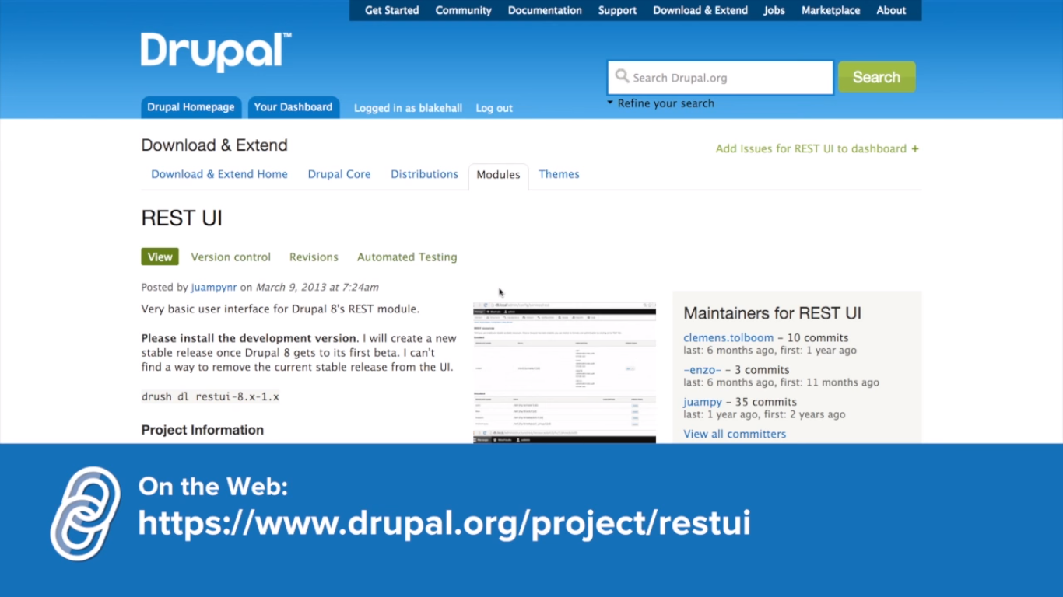
REST API Installation with Drupal8

Slide 38
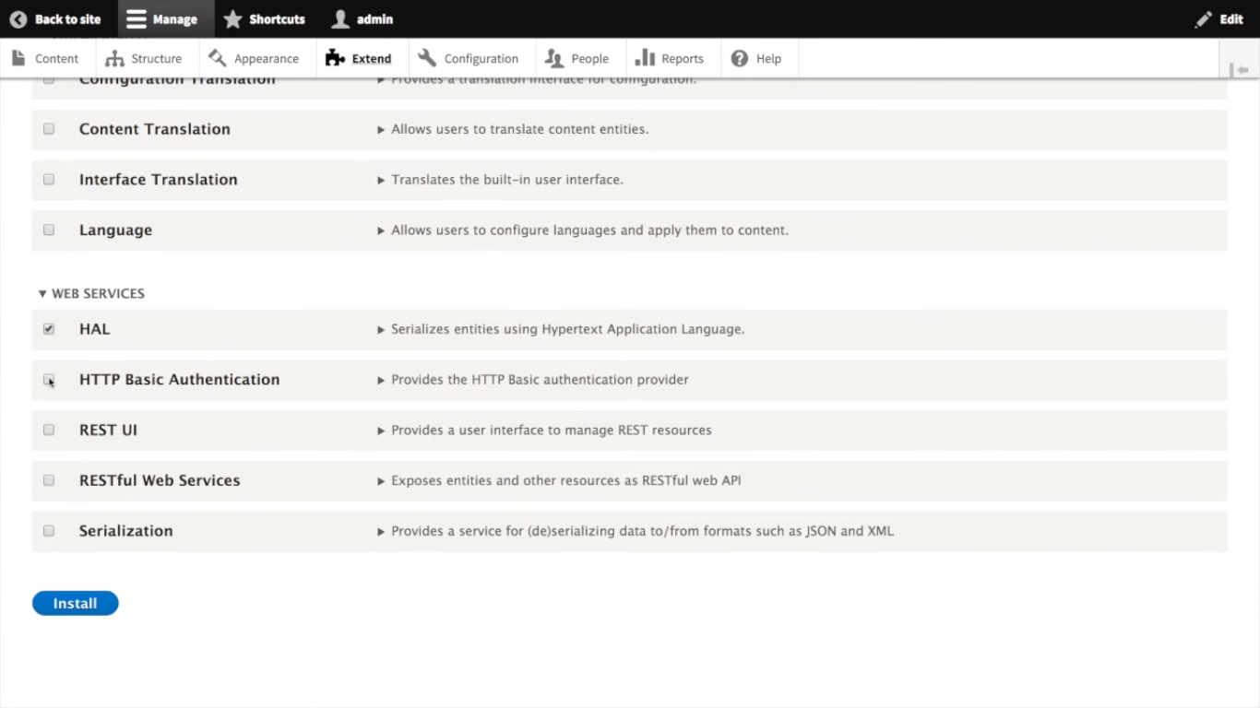
REST API Installation with Drupal8

Slide 39
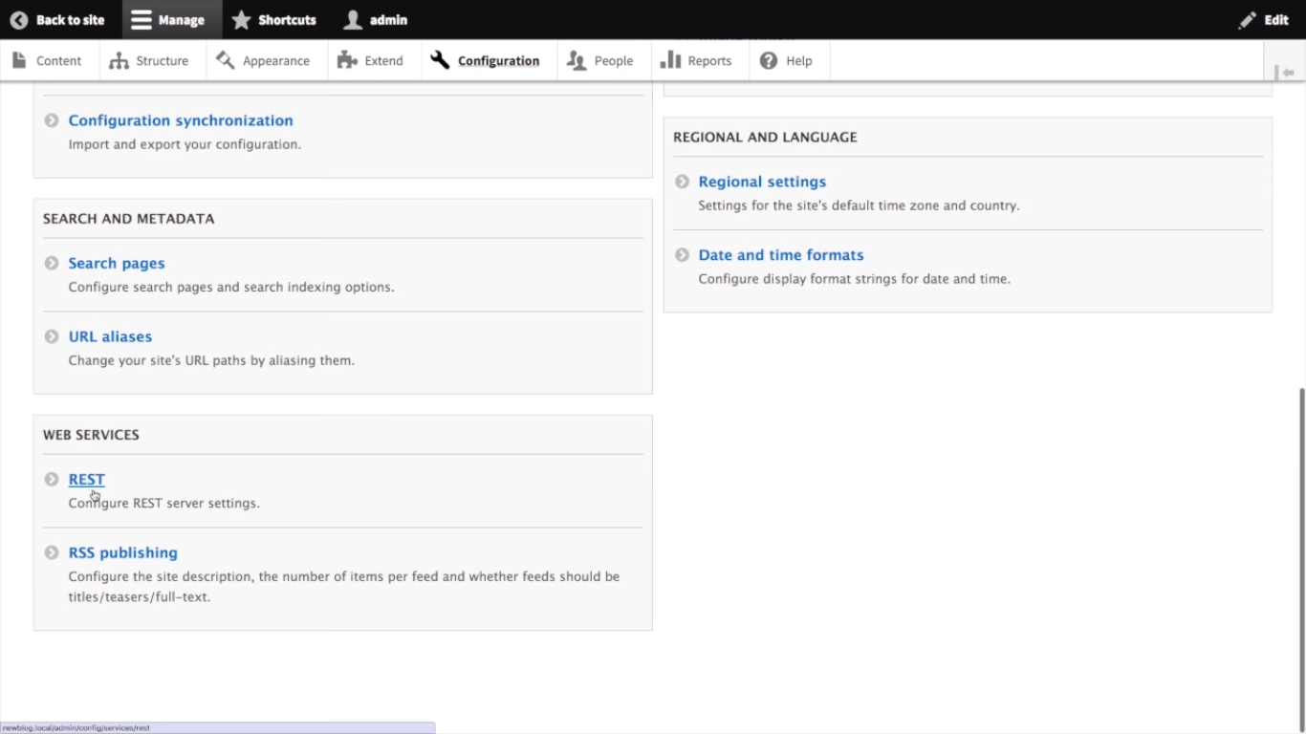
REST API Installation with Drupal8

Slide 40
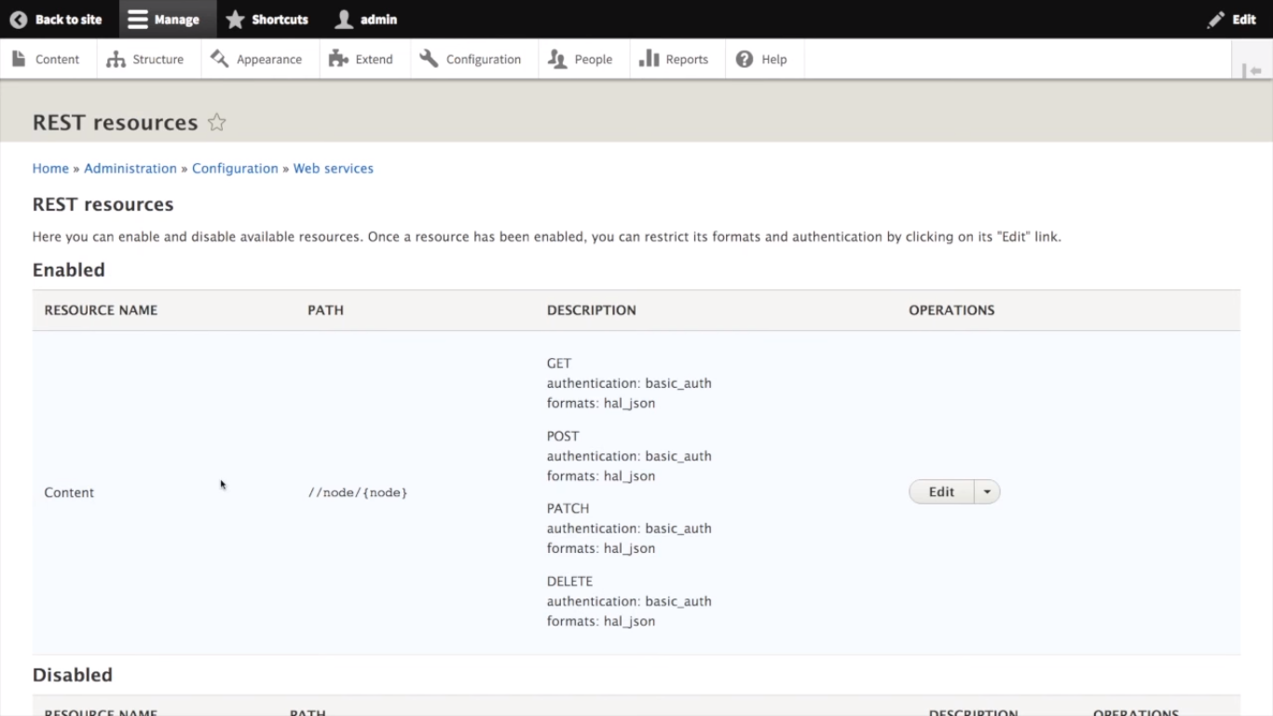
REST API Installation with Drupal8

Slide 41
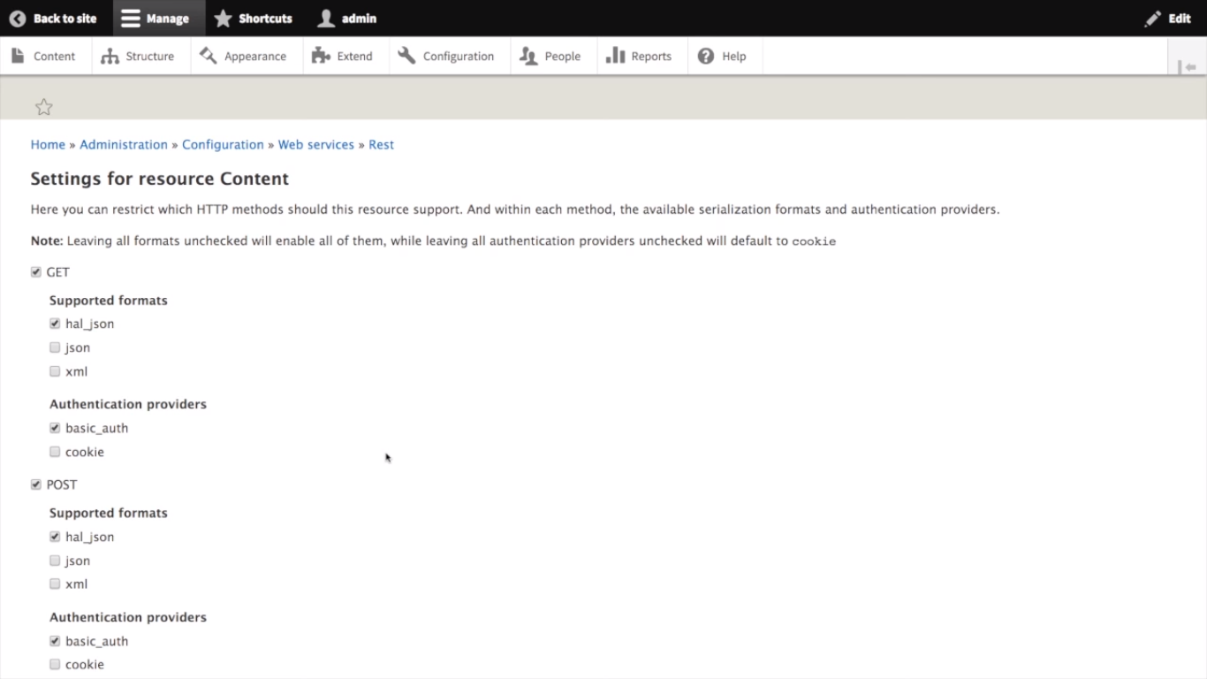
REST API Installation with Drupal8

Slide 42
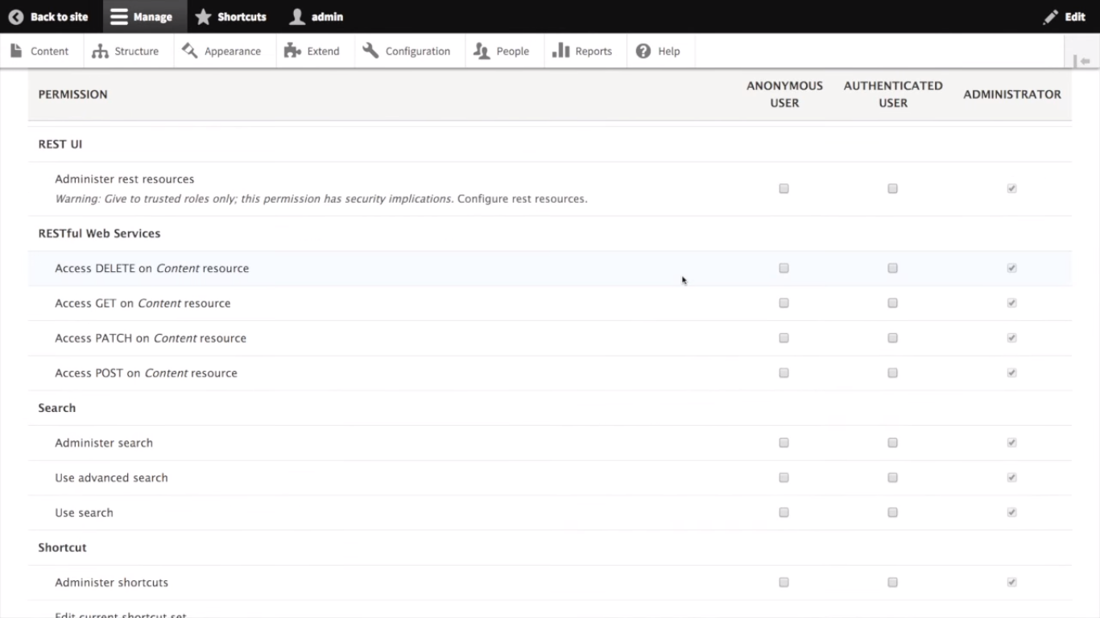
REST API Installation with Drupal8

Slide 43
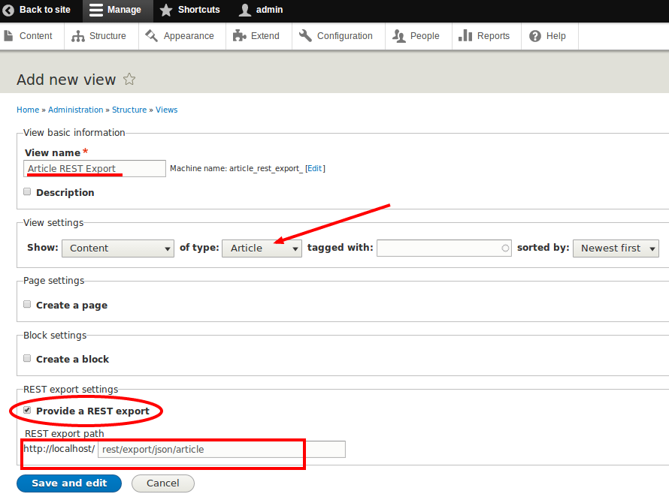
REST API Configration

Slide 44
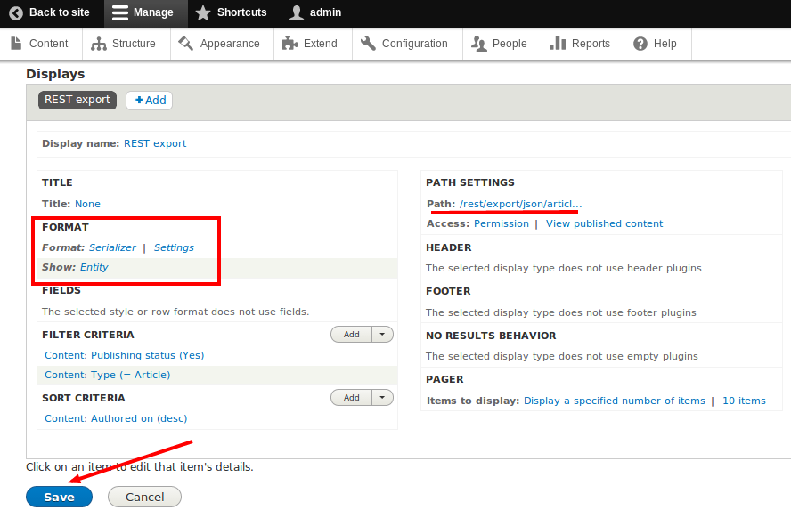
REST API Configuration

Slide 45
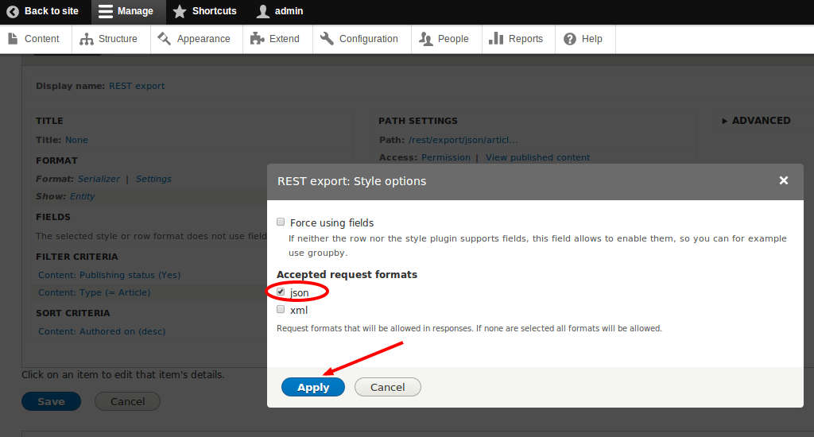
REST API Configuration
Tick the box against “json” since the data will be in json format. Click “Apply”. Finally, save the view by clicking the "Save" button.

Slide 46
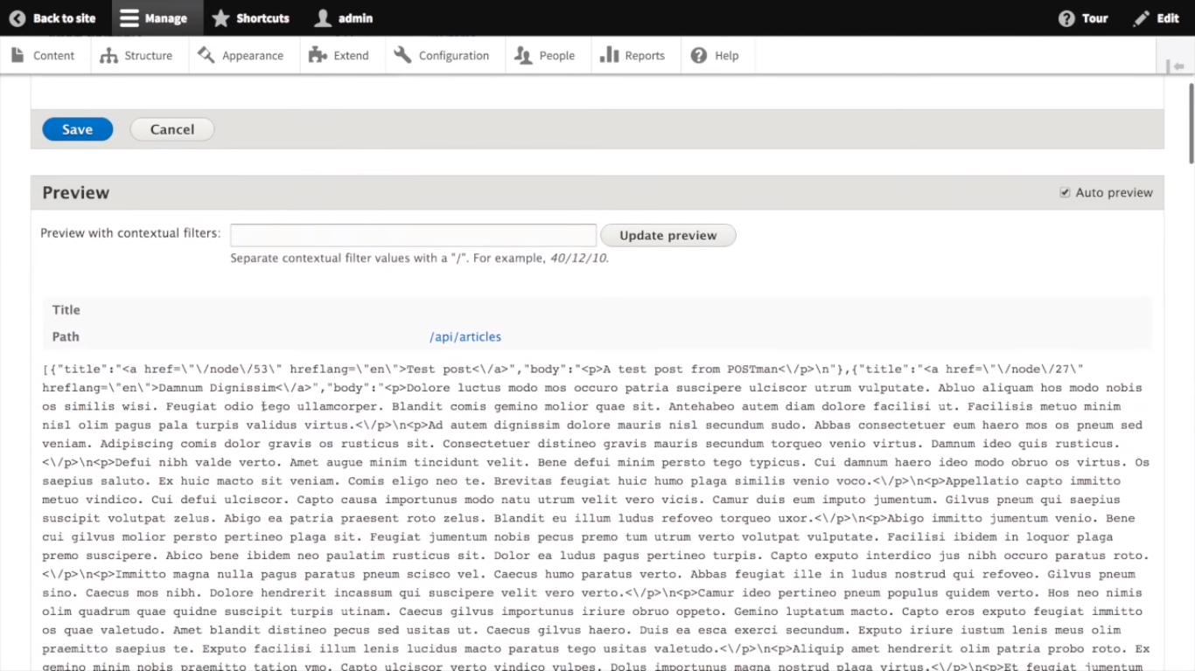
REST API Configration

Slide 47
REST API Configration
Once you saved the view, you can test the end point using any REST client. Here, we are using "Advanced REST client", an extension of Google Chrome browser. For installing this, type in "https://chrome.google.com/webstore/category/apps" in your Google Chrome browser. Search for "rest client" as shown in the image below. You will find "Advanced REST client". Click "FREE" to install the application.

Slide 48
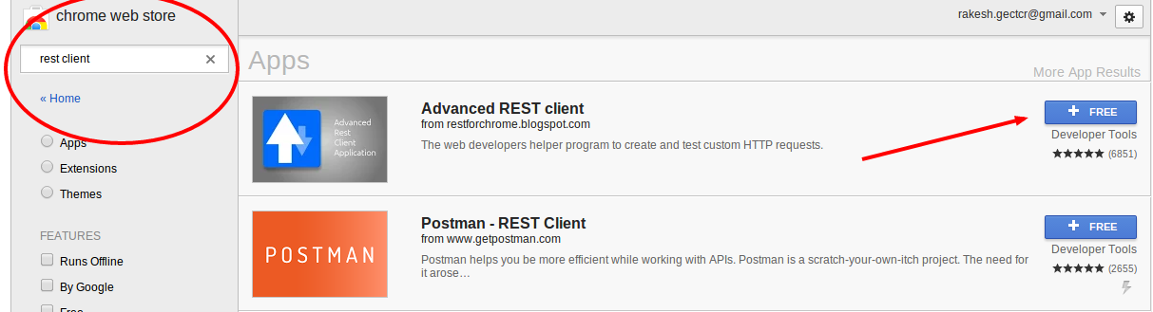
REST API Configration

Slide 49
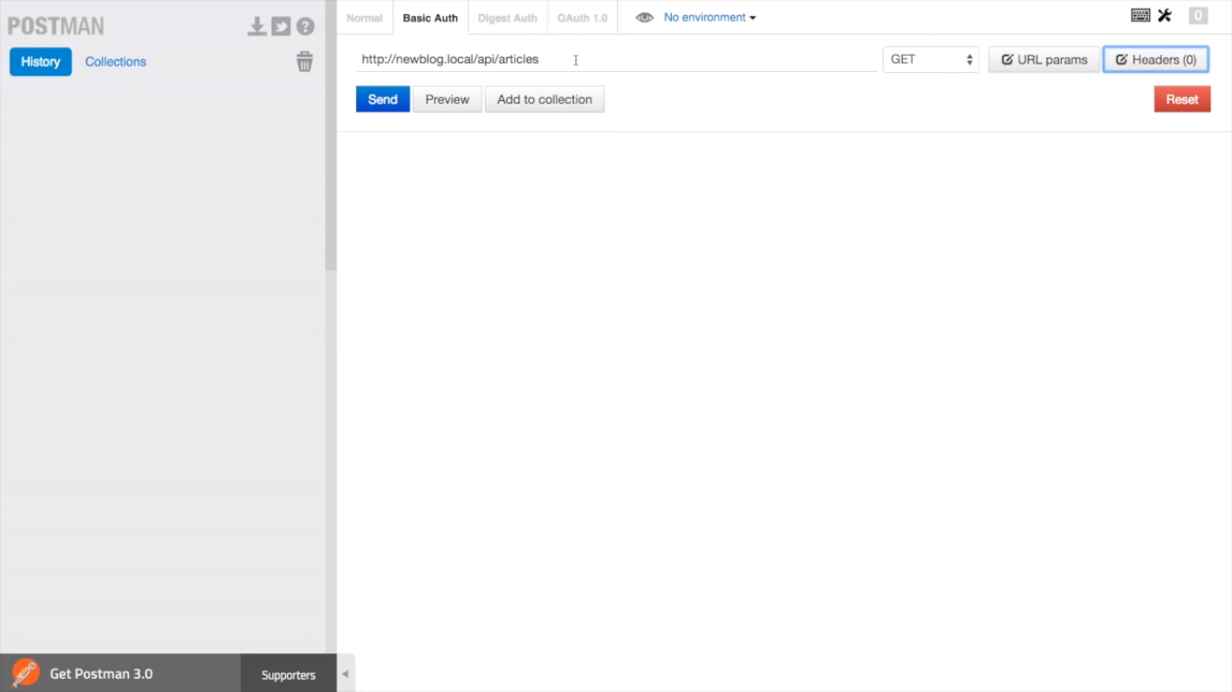
REST API Configration

Slide 50
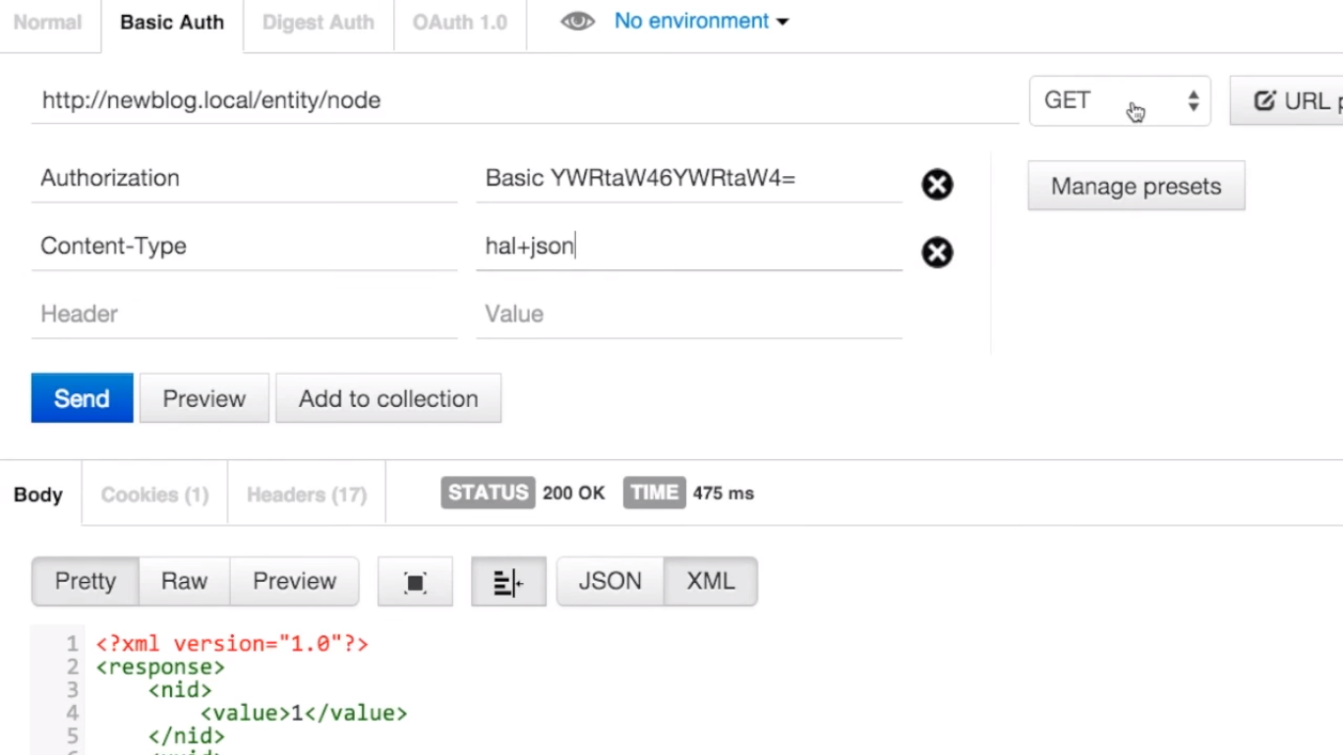
REST API Configration

Slide 51
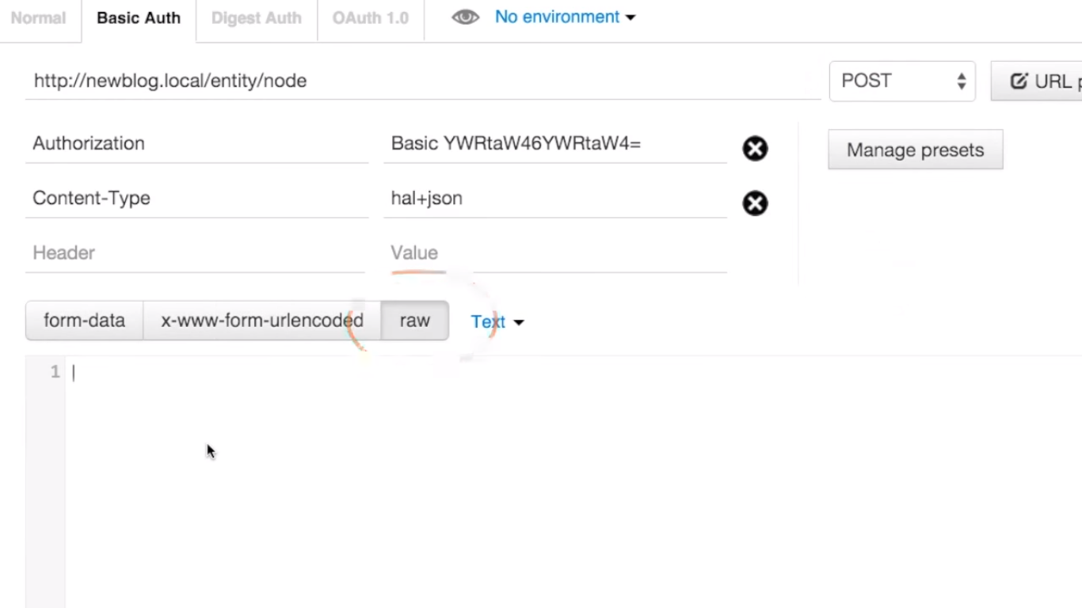
REST API Configration

Slide 52
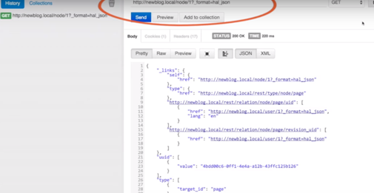
REST API Configration

Slide 53
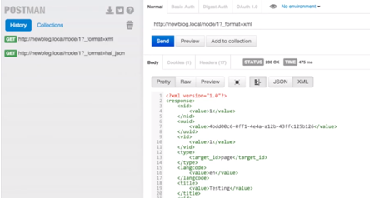
REST API Configration

Slide 54
REST API Configration
After installing the rest client, go to the path "chrome://apps/" on your Google Chrome browser or click the "Apps" icon on the bookmarks bar of your Google-Chrome browser. Then select the "Advanced REST client" application.

Slide 55
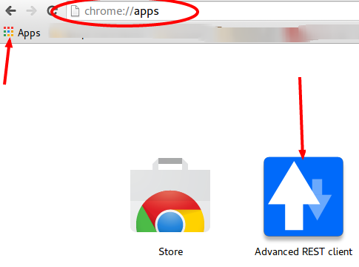
REST API Configration

Slide 56
REST API Configration
In "Advanced REST client", we need to provide the path of the end point. Here our path is “http://localhost/rest/export/json/article”. Select "GET" and click "Send" as shown in the following picture.

Slide 57
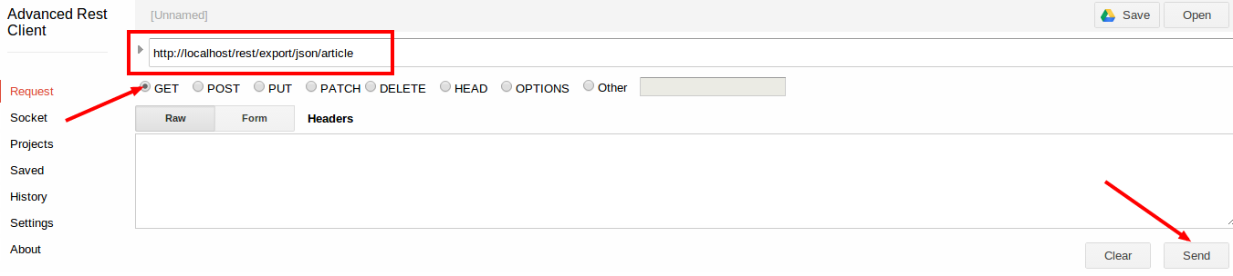
REST API Configration
After you send the request, you will get a response "Status Code: 200 - OK", which is a standard response for successful HTTP requests. This is how the successful response looks:

Slide 58
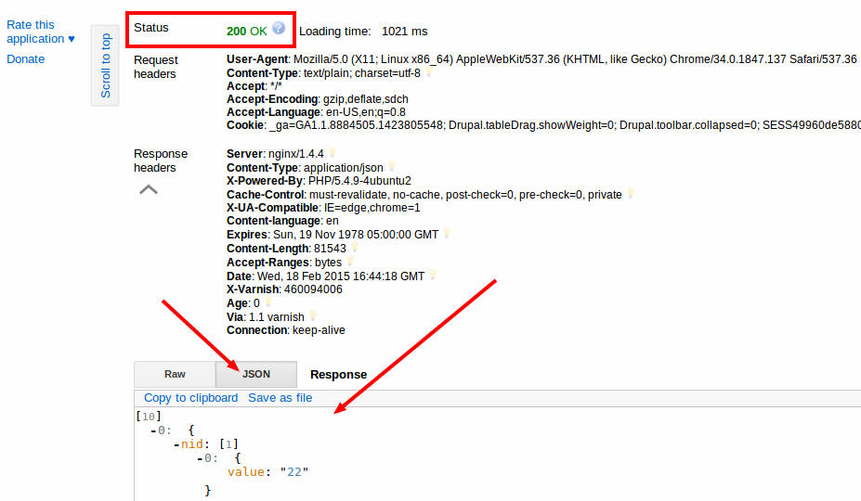
REST API Configration

